Slide 1
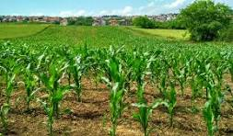
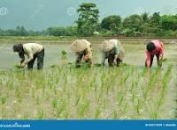
Project-2025 Village Name- Apoorva Nagar
Calculation of profit/loss of crop of 25 Farmer's on total cultivated land in one year.

Slide 2
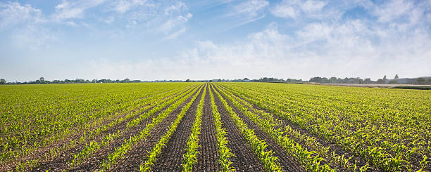
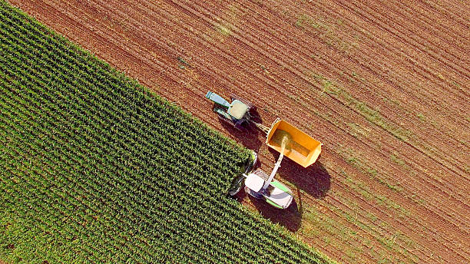
Project Goals
Income expenditure analysis of 25 of farmers.
Comparison of the amount of land income of Rice ,Eggplant, Mazie cultivation.
Net profit and assess the financial condition of village farmers.
1. Average income-112596.15 BDT
Expenditure income-37230.76 BDT
Total Rice of land-81.5 Acre
Total Eggplant of land-98.5 Acre
Total Maize of land-95 Acre
Total net profit-1884000 BDT

Slide 3
Data of the crops cultivated by the farmers
Project-2024 Village Name- Apoorva Nagar Calculation of profit/loss of crop of 25 farmer's on total cultivated land in one year.
SL No- | Name of Farmer's | The name of cultivated crops and acres of land |  |  |  |  |  |  |  |  | Gross Income(BDT.) Paddy+Eggplant+Maize | Total Expenditure(BDT.) Paddy+Eggplant+Maize | Net Profit(BDT.) | Total land (Acres)
 |  | Paddy/rice |  |  | Eggplant |  |  | Maize
 |  | Acre | Income (BDT.) | Expenditure (BDT.) | Acre | Income (BDT.) | Expenditure (BDT.) | Acre | Income (BDT.) | Expenditure (BDT.)
1 | AL-Amin | 0.5 | 2500 | 1000 | 7 | 70000 | 21000 | 2.5 | 37500 | 12500 | 110000 | 34500 | 75500 | 10
2 | Babu | 1 | 5000 | 2000 | 6.5 | 65000 | 19500 | 3 | 45000 | 15000 | 115000 | 36500 | 78500 | 10.5
3 | Chand | 1.5 | 7500 | 3000 | 6 | 60000 | 18000 | 3.5 | 52500 | 17500 | 120000 | 38500 | 81500 | 11
4 | Dikhul | 2 | 10000 | 4000 | 5.5 | 55000 | 16500 | 4 | 60000 | 20000 | 125000 | 40500 | 84500 | 11.5
5 | Ebrahim | 2.5 | 12500 | 5000 | 5 | 50000 | 15000 | 4.5 | 67500 | 22500 | 130000 | 42500 | 87500 | 12
6 | Faizur | 3 | 15000 | 6000 | 4.5 | 45000 | 13500 | 5 | 75000 | 25000 | 135000 | 44500 | 90500 | 12.5
7 | Golam rabbani | 3.5 | 17500 | 7000 | 4 | 40000 | 12000 | 5.5 | 82500 | 27500 | 140000 | 46500 | 93500 | 13
8 | Halim | 4 | 20000 | 8000 | 3.5 | 35000 | 10500 | 6 | 90000 | 30000 | 145000 | 48500 | 96500 | 13.5
9 | Ikram | 4.5 | 22500 | 9000 | 3 | 30000 | 9000 | 6.5 | 97500 | 32500 | 150000 | 50500 | 99500 | 14
10 | Jamal | 5 | 25000 | 10000 | 2.5 | 25000 | 7500 | 7 | 105000 | 35000 | 155000 | 52500 | 102500 | 14.5
11 | Kalam | 6 | 30000 | 12000 | 2 | 20000 | 6000 | 6.5 | 97500 | 32500 | 147500 | 50500 | 97000 | 14.5
12 | Lal mia | 5.5 | 27500 | 11000 | 1.5 | 15000 | 4500 | 6 | 90000 | 30000 | 132500 | 45500 | 87000 | 13
13 | Mannan | 5 | 25000 | 10000 | 1 | 10000 | 3000 | 5.5 | 82500 | 27500 | 117500 | 40500 | 77000 | 11.5
14 | Naim | 4.5 | 22500 | 9000 | 1.5 | 15000 | 4500 | 5 | 75000 | 25000 | 112500 | 38500 | 74000 | 11
15 | Omor | 4 | 20000 | 8000 | 2 | 20000 | 6000 | 4.5 | 67500 | 22500 | 107500 | 36500 | 71000 | 10.5
16 | Pavel | 3.5 | 17500 | 7000 | 2.5 | 25000 | 7500 | 4 | 60000 | 20000 | 102500 | 34500 | 68000 | 10
17 | Qurban | 3 | 15000 | 6000 | 3 | 30000 | 9000 | 3.5 | 52500 | 17500 | 97500 | 32500 | 65000 | 9.5
18 | Rahaman | 2.5 | 12500 | 5000 | 3.5 | 35000 | 10500 | 3 | 45000 | 15000 | 92500 | 30500 | 62000 | 9
19 | Salam | 2 | 10000 | 4000 | 4 | 40000 | 12000 | 2.5 | 37500 | 12500 | 87500 | 28500 | 59000 | 8.5
20 | Tawfiq | 1.5 | 7500 | 3000 | 4.5 | 45000 | 13500 | 2 | 30000 | 10000 | 82500 | 26500 | 56000 | 8
21 | Urban | 1 | 5000 | 2000 | 5 | 50000 | 15000 | 1.5 | 22500 | 7500 | 77500 | 24500 | 53000 | 7.5
22 | V-dlip | 0.5 | 2500 | 1000 | 5.5 | 55000 | 16500 | 1 | 15000 | 5000 | 72500 | 22500 | 50000 | 7
23 | Wasqurini | 4 | 20000 | 8000 | 6 | 60000 | 18000 | 0.5 | 7500 | 2500 | 87500 | 28500 | 59000 | 10.5
24 | X-bin | 5 | 25000 | 10000 | 3.5 | 35000 | 10500 | 0 | 0 | 0 | 60000 | 20500 | 39500 | 8.5
25 | yunus | 6 | 30000 | 12000 | 5.5 | 55000 | 16500 | 2 | 30000 | 10000 | 115000 | 38500 | 76500 | 13.5

Slide 4
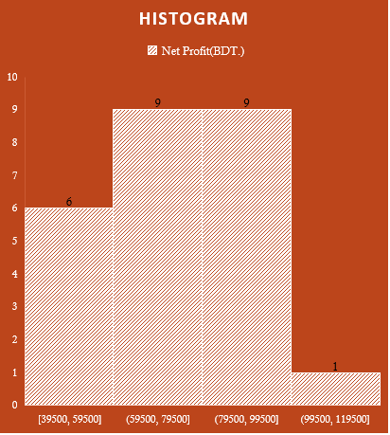
Analysis of Income Expenditure and Net Profit in Graph and Chart
Bar Chart
Histogram
Pie-Chart

Slide 5



Formula of Average Income, Expenditure, Net Profit
Average Income
Average Expenditure
Average Net Profit
=AVERAGEA(N9,N9:N33)
=AVERAGE (L9,L9:L33)
=AVERAGE (M9,M9:M33)

Slide 6

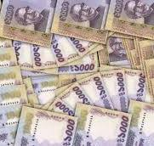
Highest and Lowest Net Profit
Lowest net Profit-39500 BDT.
Name of farmer-X-bin
Highest Net Profit-102500 BDT.
Name of farmer-Jamal
=MAX(N9,N9:N33)
=MIN(N9,N9:N33)

Slide 7
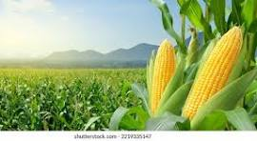
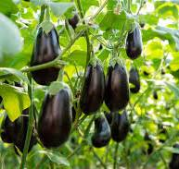
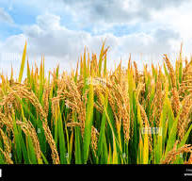
Project findings and Recommendation
The financial condition of the farmers in this village is good.
The farmer does not incur any loss in growing the crop.
Corn crop is the most profitable in this village.
Farmers will benefit more if corn crop is increased in this village.
More profit can be made if fertilizers are applied according to rules in crop cultivation.

Slide 8
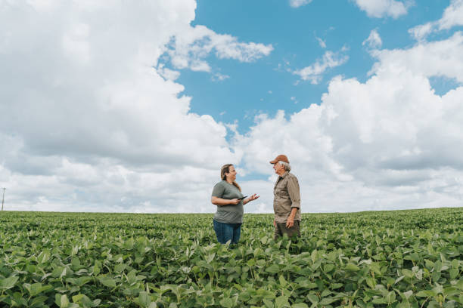


Thank you for your Patience
Any Question?

